Slide 1
Introduction to Generative AI
AI systems that create content
Uses deep learning models
Text, images, audio generation

Slide 2
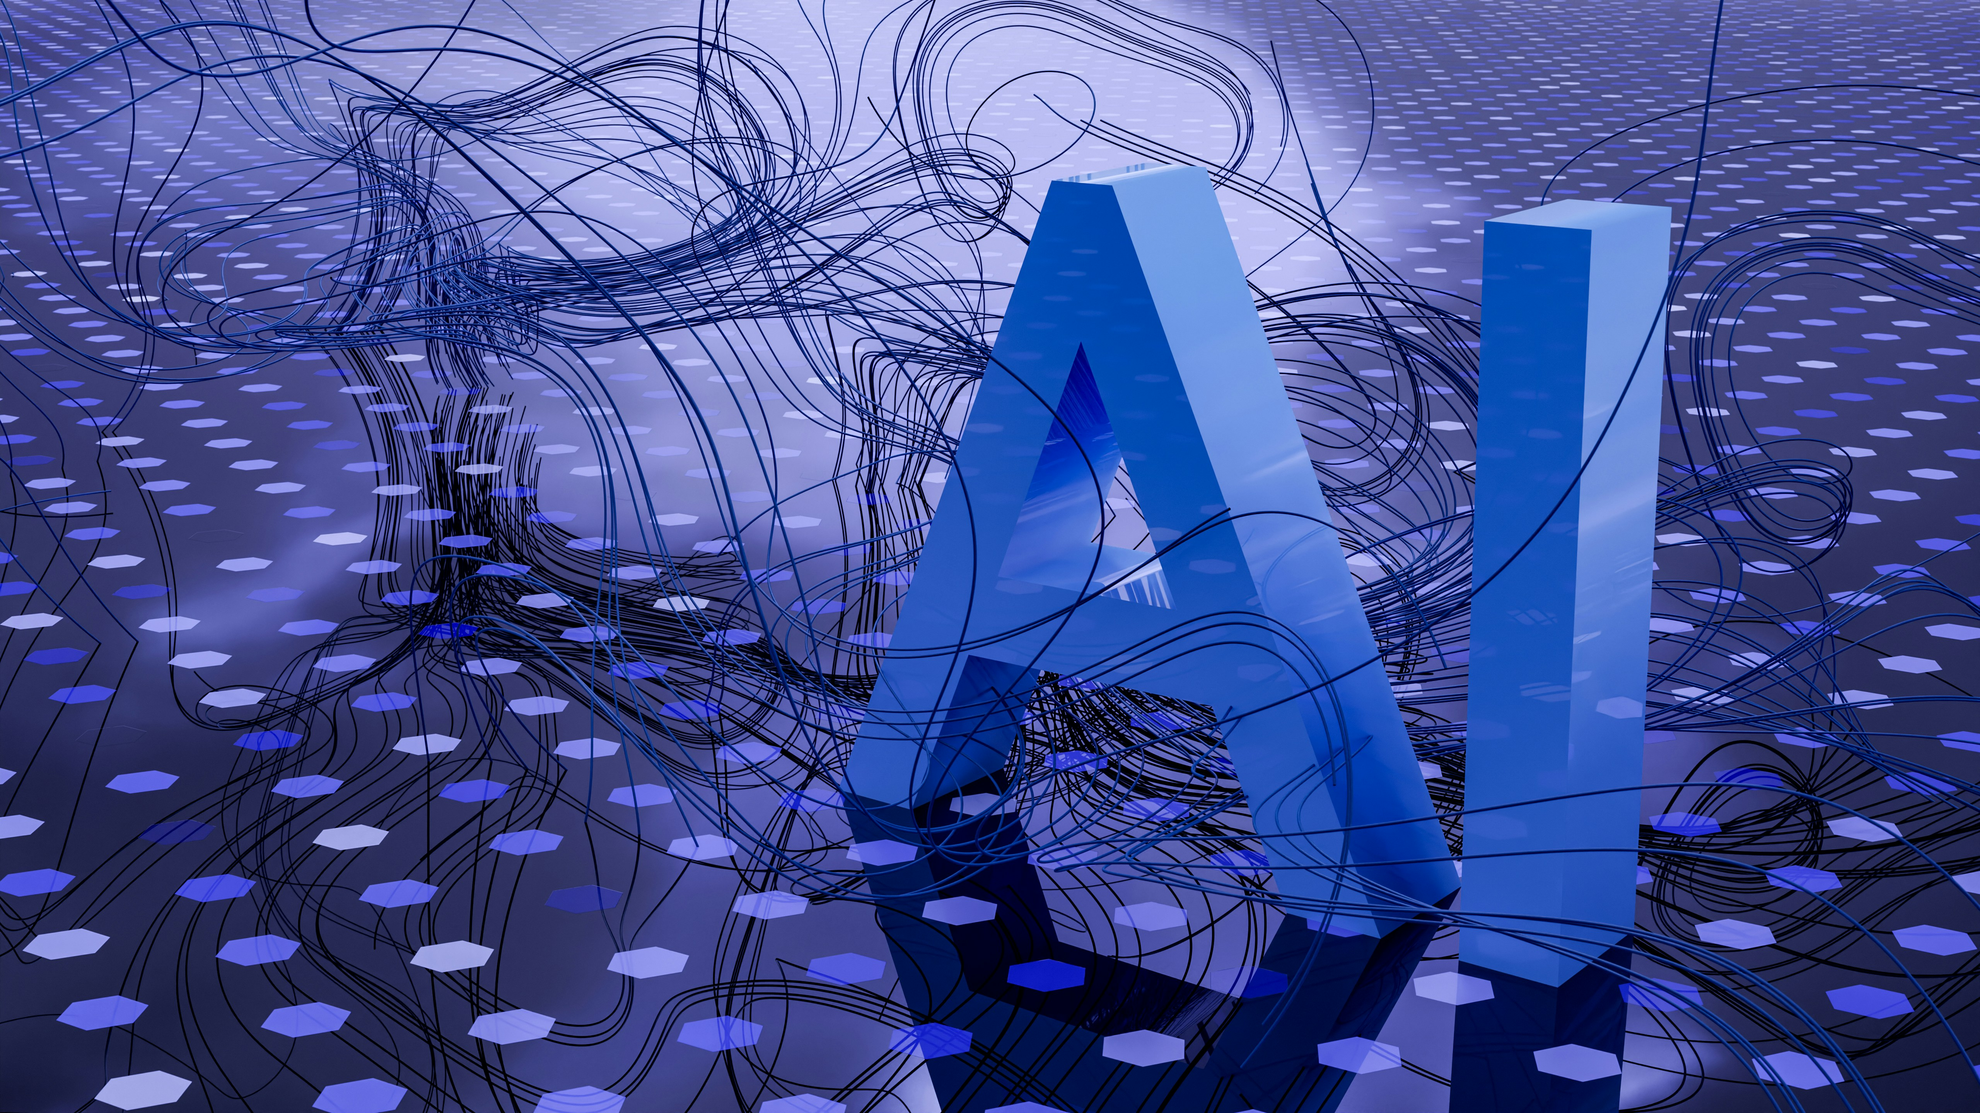
Applications
Chatbots and assistants
Image generation
Code generation

